Slide 1
Fire in Your Hands: Understanding Thermal Behavior of Smartphones
Soowon Kang∗, Hyeonwoo Choi†, Sooyoung Park∗, Chunjong Park‡, Jemin Lee§, Uichin Lee∗, Sung-Ju Lee∗
∗KAIST, †Samsung Electronics, ‡University of Washington, §ETRI
Conference Accepted: MobiCom 2019
Notes:
Human-Computer Interaction, Social Computing Systems, and Mobile Pervasive Computing.
Networking and mobile systems

Slide 2
Presenter: Song Yang^{[1]}, Xin Yang^{[2]}
Department of Electrical and Computer Engineering
Rutgers University
^{[1]}sea.yang@rutgers.edu, ^{[2]}xin.yang@rutgers.edu

Slide 3
Outline
Background
Related Work
Approaches & Solutions
Results
Summary
Future Work

Slide 4
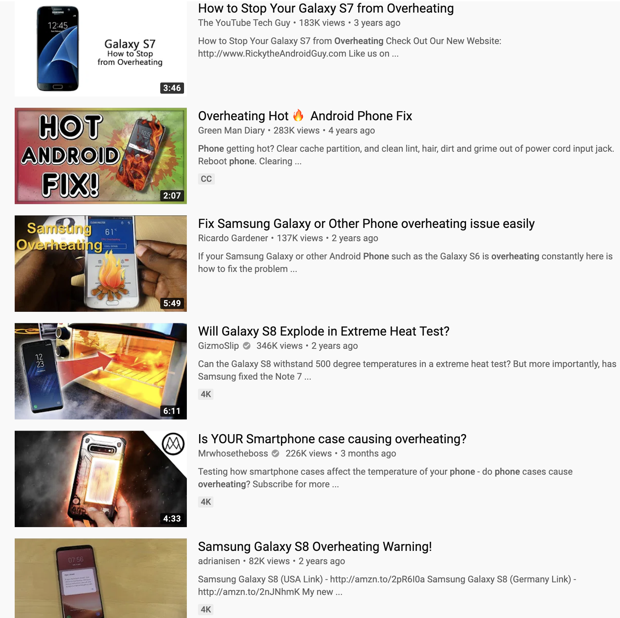
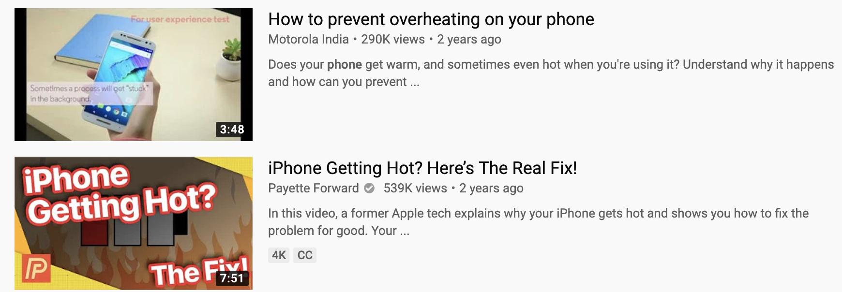
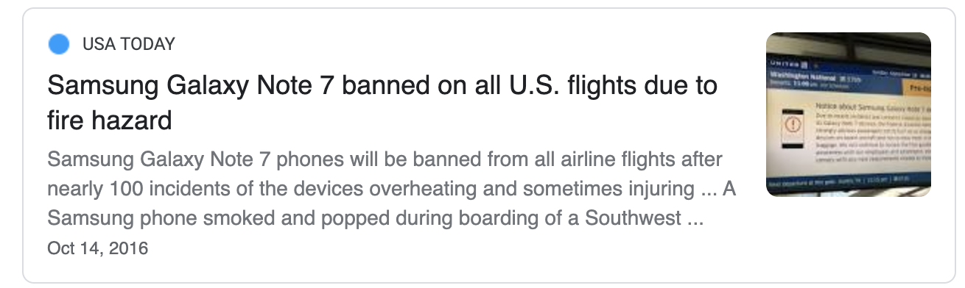
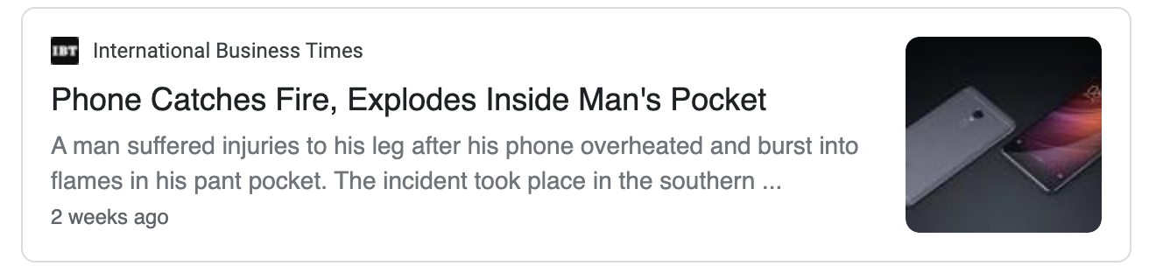
Background - Overheating Smartphones

Slide 5
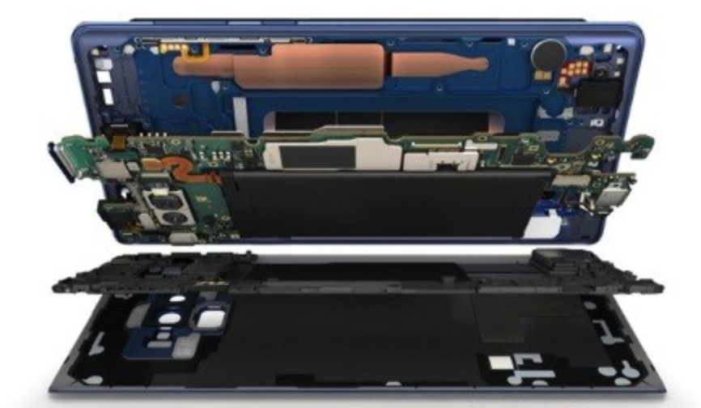
Background - Heat Transfer Basics
Two major heat transfer routes: Conduction & Convection
Smartphones are comprised of multiple layers, heat mostly transfer in vertical directions across multiple layers
Heat releases to the air with the temperature change rate decreases and finally reaches a steady-state (steady-state temperature)
Minor Heat Transfer
Major Heat Transfer
Notes:
Layer surface area is wide and thin, air work as insulator

Slide 6
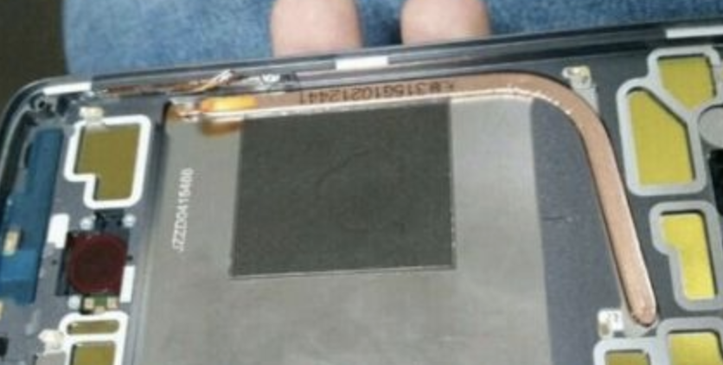
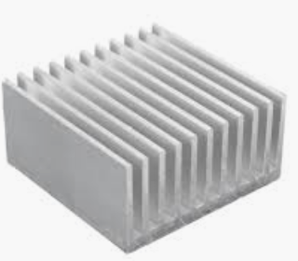
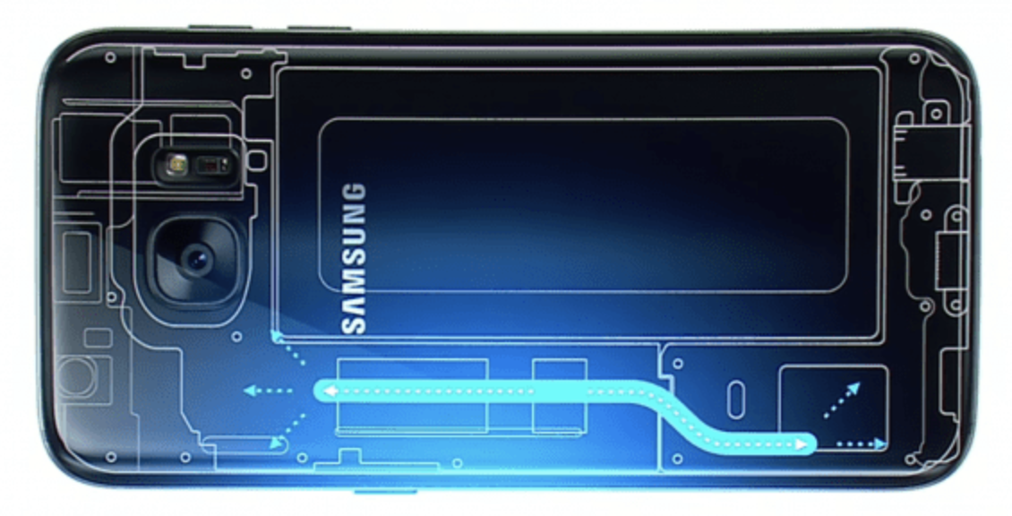
Background - Mobile Thermal Management Techniques
Passive Cooling
Heat Pipe, Heat Sink, Thermal Interface Materials (Silicone Elastomer)
Active Cooling (Not suitable for smartphones)
Forced Air, Forced Liquid Cooling
Electronic Component-level Thermal Management
Dynamic Voltage and Frequency Scaling (DVFS), CPU hot-plug
Operating System Kernel-level Thermal Management
Android (Linux Kernel): Thermal Engine
Heat Pipe
Heat Sink
Phone Liquid Cooling
Notes:
There’s a tube containing a liquid that vaporizes at high temperatures and then condenses at low temperatures,

Slide 7
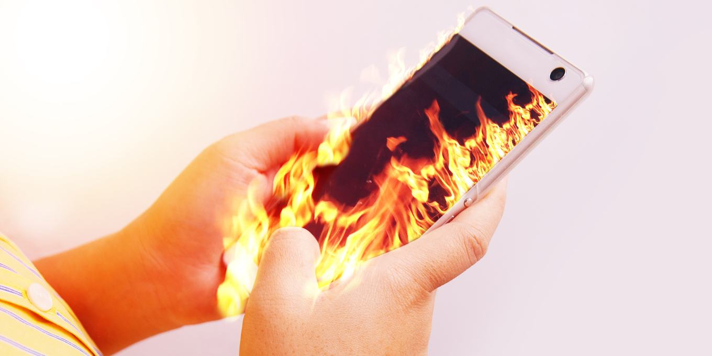
Motivation
Smartphone overheating causes numerous issues, e.g., degraded performance, battery damage, and health threats
Cooling the phone is challenging for its small size and high power density
Lack of a systematic measurement and user experience study on the thermal issues of smartphones in practical scenarios
Notes:
(e.g., thermal pain, skin burns, skin aging)
(when and how much heat the phone (and each compunent) will generate)

Slide 8
Problem Statement
When and How much heat a smartphone would generate under various workloads？
How would the overheating impact user experience?
Are existing thermal management methods sufficient?
Can we further improve the overheating issues on smartphones?

Slide 9
Related Work
Smartphone-based Thermal Management & Prediction:
Only measure/predict the temperature of application processors (APs)
Use limited data acquired from hard-to-access kernel-level hardware
Use simple linear regression for modeling
Thermal Models and Simulations for Smartphones:
Study hardware-level heat dissipation
Don’t consider various application workloads
Thermal Conditions and User Experience:
No systematic analysis on surface and component-level temperature measurement
Don’t involve various recent smartphone under various application workloads
Notes:
, whereas surface temperature directly affect user experience
Video resolution, clock frequency

Slide 10
Approaches & Solutions
Thermal Measurement Setup
In-depth Thermal Measurement
User Experience Study
Surface Temperature Prediction Model

Slide 11
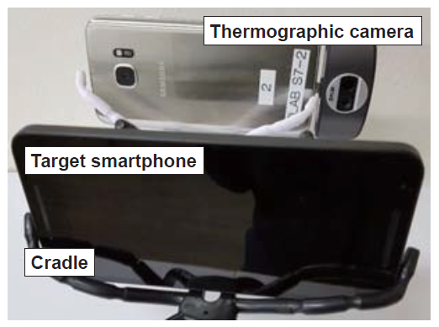
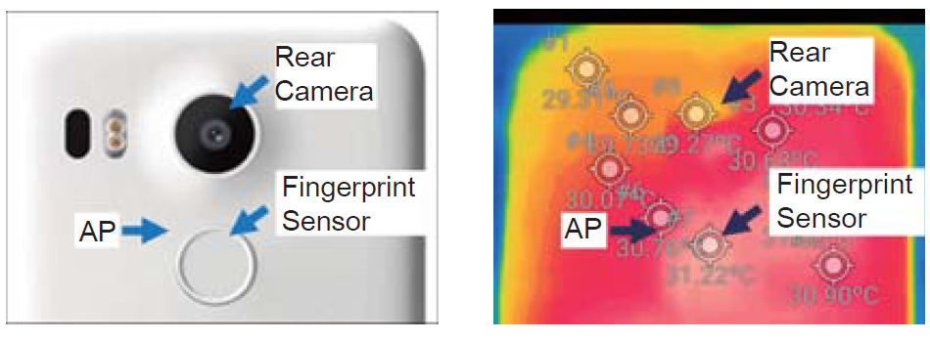
Thermal Measurement Setup
Devices:
Infrared (IR) cameras (Sampling rate: 0.3Hz)
Android reference phones, Android phones, iOS phones
Focused hardwares:
Application processor (AP)
Camera
Wireless network chipset
Metric
Root mean square error (RMSE)
Measurement setup
VIsible light image and infrared image of the rear side of the Nexus 5X
Notes:
Capture 18 temperature samples per minute.
General understanding of thermal characteristic

Slide 12
In-depth Thermal Measurement
Surface Thermal Measurement
Overview: Use IR camera to measure the surface temperature of the phone in various usage scenarios.
Objective: For a in-depth understanding of smartphone thermal characteristics in various scenarios.
Scenarios: Video call, video recording, voice call, game, charging
Component-level Thermal Measurement
Overview: Measure the temperature of the printed circuit board (PCB) of 6 components in various usage scenarios.
Objective: To identify the main heat source in each scenario.
Measured components: Application processor (AP), power management integrated circuits (PMICs), rear camera, and battery.

Slide 13
User Experience Study
Objective:
Understand how much heat and discomfort users feel when use smartphone for a long time and users’ reaction patterns.
Data Collection:
20 participants (Male/Female=1:1), average age ≈ 21
Experimental Devices:
Nexus 5X, Samsung S7
Scenarios:
20 minutes of game play (Yokai Saga)
Evaluation Metrics:
Phone temperature is measured via thermographic camera.
Participants rate the level of heat sensation (1: Not at all, 2: Little, 3: Somewhat, 4: Very much, 5: Extremely)
Notes:
When participants played the game, we rec- ommended them to hold the phone in the landscape-mode with their hands; this recommendation was made to avoid the case of laying the phone on the desk.
we counter-balanced the order such that a half of them used Nexus 5X first, and the other half used Galaxy S7 first. Each participant was rewarded with a $10 gift voucher.

Slide 14


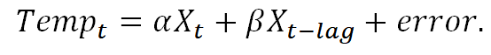
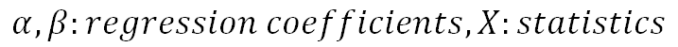
Surface Temperature Prediction Model
Thermal data
CPU temp
Battery temp
Tx, Rx data rate
System
UserTime
System kernel Space
CPU freq
...
Data collection
Devices: Nexus 5X and Galaxy S7
Collected data: 21 system statistics
Duration: 1200 min total, collect data every 5 seconds
Feature Extraction and Selection
Use Weka tool to extract features.
Use a correlation-based feature selection method.
Prediction Model Design
Time-lagging preprocessing
Use multiple regression to build a prediction model as follows:
21 system statistics
Feature Extraction and Selection
Surface Temperature Prediction Model

Slide 15
Results
Surface Thermal Measurement
Component-level Thermal Measurement
User Experience Study
Temperature Prediction Model Evaluation

Slide 16
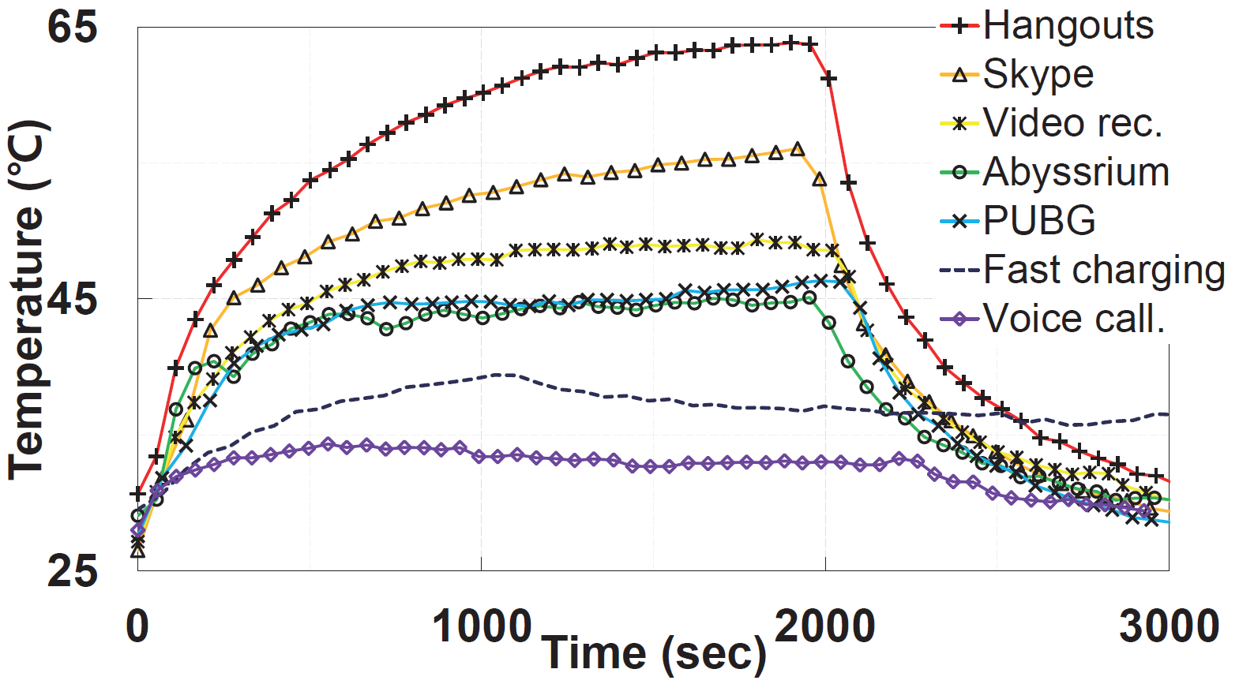
Results - Surface Thermal Measurement
Heating Conclusions:
Video call and video recording take only 8 min to make the temperature exceed thermal pain threshold.
Gaming for a long duration can be a source of thermal.
Voice call and battery charging by itself would not likely cause thermal problems.
Cooling conclusions:
The cooling down trends are similar for all scenarios.
The temperature changes while running different applications
Thermal pain threshold [1]
[1] J. Lawrence and J. Bull. Thermal conditions which cause skin burns. Engineering in Medicine, 5(3):61–63, 1976.
Notes:
Video call shows the highest temperature. However voice call shows the lowest temperature.
Converges at different temperatures while heating.
The researcher tested on 3 Nexus 5x and they all show similar results.

Slide 17
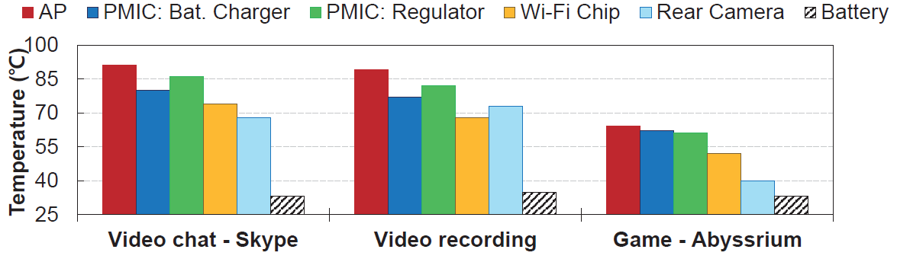
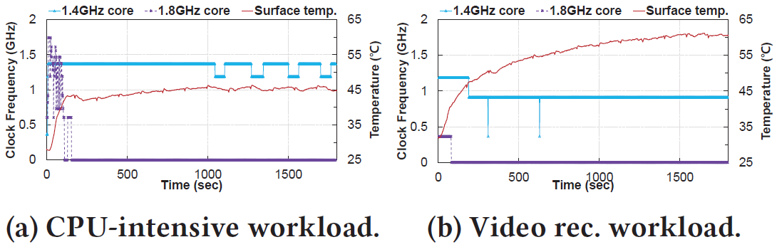
Results - Component-level Thermal Measurement
Main heat source analysis
For video call and recording, high temperature is from heavy computation and camera usage.
GPU in AP is the main heat source in mobile gaming.
CPU in AP can control the surface temperature under 46℃ by frequency scaling and core disabling in CPU-intensive workload.
For the Wi-Fi chip, higher Tx data rate leads to higher the temperature.
Surface temperature during CPU-intensive work loading.
Notes:
Application processor contain multiple modules such as CPU, GPU multimedia codec and memory… we need to determine which part may cause surface overheating.

Slide 18
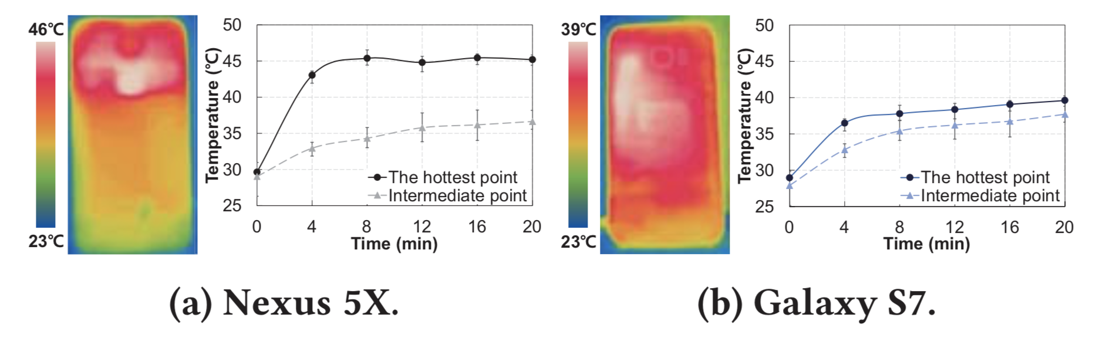
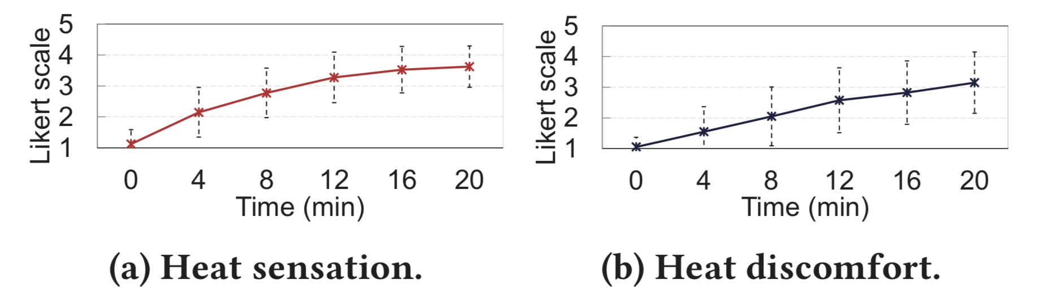
Results - User Experience Study
Heat Sensation and Discomfort
Heat sensation and discomfort increase with the temperature
75% participants report discomfort due to surface heat
Discomfort gets worse although heat sensation remains steady
Glass surface gives worse experience than plastic surface
Interaction Behaviors:
95% participants changed grips and stretched hands, 35% complain for heat and sweat
Surface temperature during a gameplay.
Heat sensation and discomfort during gameplay
(error bars denote standard deviation).
Likert Scale: 1: Not at all, 2: Little, 3: Somewhat, 4: Very much, 5: Extremely

Slide 19
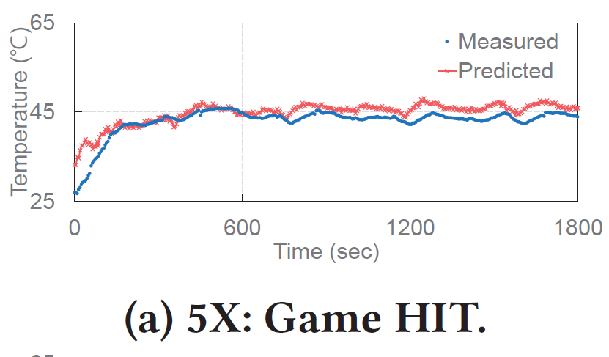
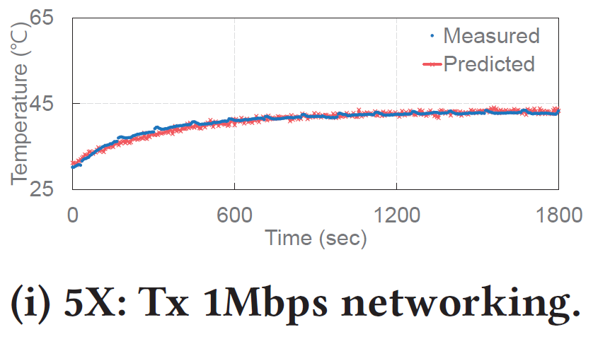
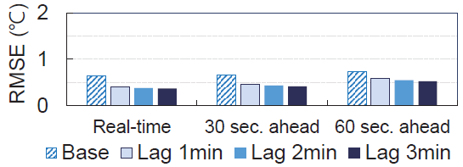
Results - Temperature Prediction Model Evaluation
Overall, root mean square error (RMSE) < 2℃ in most cases.
Leave-one-scenario-out Evaluation (w/ 3 min lagging data)
1.20℃ RMSE for Nexus 5s.
0.523℃ RMSE for Galaxy S7.
Gaming scenario perform worse than other scenarios.
The model performs worse as the timeline goes farther.
The result can also be improved with longer lagging time.
Prediction accuracy in gaming and video recording
Prediction accuracy with different time lagging.

Slide 20
Summary
Investigated smartphone thermal issues under various workloads.
Observations:
Many applications, especially camera-based apps generate massive heat to cause thermal pain.
Major heat sources include application processors, camera, and power management modules.
75% participants have discomfort caused by heat when playing a game.
Overheating disrupts user interaction flow and even causes interaction errors.
Solution:
Built a smartphone surface temperature prediction model based on system statistics that achieves MSE < 2%.
Notes:
Statement
Observation
Solutions

Slide 21
Limitations and Future Work
Limitations:
Generalization of the temperature prediction.
The impact of diverse of in-game events.
Running multiple applications at the same time.
Future Work:
Explore various methods of improving prediction accuracy by considering more diverse hardware stats and leveraging prediction algorithms.
Examine diverse coexistent scenarios.
Our Opinions:
Thermal management mechanisms between iOS and Android systems.
Further investigate how the design of products influence thermal performance and user experience.
Notes:
Background app are mostly CPU intensive workloads.

Slide 22
Thanks!
Q&A

Slide 23
Question 1
Q: Does this work indicate the using of low power mode and the relationship between battery level and heat?
A: This work perform all experiments under standard power mode. The authors briefly discussed the relationship between battery levels and generated heat when charging the phone, but didn’t involve the detailed relationship study in their work.
Notes:
Background app are mostly CPU intensive workloads.

Slide 24
Question 2
Q: Does this work use the proposed model to control CPUs for improvement?
A: No. This work perform experiments and collects training data with the existing thermal management methods enabled. However, the proposed model only predicts the surface temperature. The authors didn’t proposed any improvement based on their temperature prediction model.

Slide 25
Question 3
Q: How do the authors control variables in the experiments of the user experience study?
A: The participants are required to play one specific game (Yokai Saga) for 20 minutes continuously. Participants are recommended to hold the phone in landscape-mode to avoid laying the phone down on the desk.

Slide 26
Question 4
Q: Will the smartphone protection cases affect the temperature of the smartphone?
A: Yes, it will. The authors measured the temperature changes when using Skype with and without a plastic protection case. The protection case is made of Thermoplastic Poly-Urethane (TPU) and Polycarbonate (PC) (thickness=1.5mm). The results show it takes 418 seconds to reach 45℃, it took 418 seconds (SD: 22) without the case and 643 seconds (SD: 46) with the case. As a result, the protection cases will increase the heating speed of the smartphone, while the final steady-state temperatures are similar.

Slide 27
Question 5
Q: Do the authors use various in-built sensors to measure the temperature?
A: For the investigation part, the authors use an infrared (IR) camera to measure the surface and components temperature of the smartphone. There are no inbuilt sensors involved in this part. When building the temperature prediction model, the authors collected the CPU and battery temperature from inbuilt sensors as training features.

Slide 28
Question 6
Q: Is the proposed temperature prediction model general for all smartphones?
A: No. The author mentioned this in the limitations that their prediction model is device-dependent and requires a new model training process with new phones.

Slide 29
Backup Slides

Slide 30
Dynamic Voltage and Frequency Scaling (DVFS)
Two power saving techniques:
Dynamic frequency scaling
Dynamic voltage scaling
Benefits:
Helps preserve battery on mobile devices
Decreases cooling cost and noise
Security measurement for overheated systems

Slide 31
Health Threats of Smartphone Overheating
Aggravate a thermal-regulatory disorder
Thermal pain
Skin burns
Skin aging

Slide 32
Correlation-based Feature Selection (CFS)
Selects the top 8 features that are highly correlated with the predictive variable but are less correlated with one another
Based on the CorrelationAttributeEval in Weka Library
Evaluates the worth of an attribute by measuring the Pearson's correlation between it and the class.
Nominal attributes are considered on a value by value basis by treating each value as an indicator. An overall correlation for a nominal attribute is arrived at via a weighted average.

Slide 33
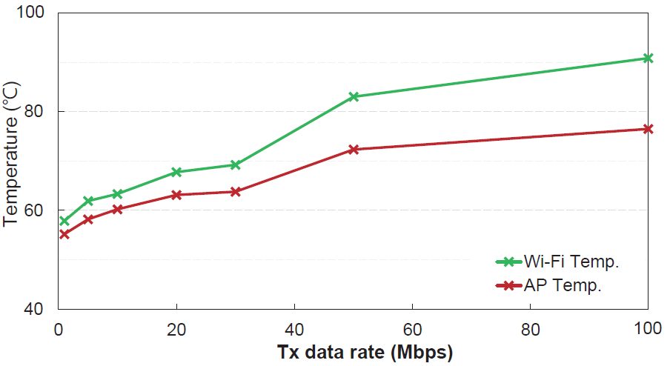
Component-level Measurement
The steady-state temperatures of AP and
Wi-Fi chip during 10 minute network transmissions.
Surface temperature during CPU-intensive work loading.

Slide 34
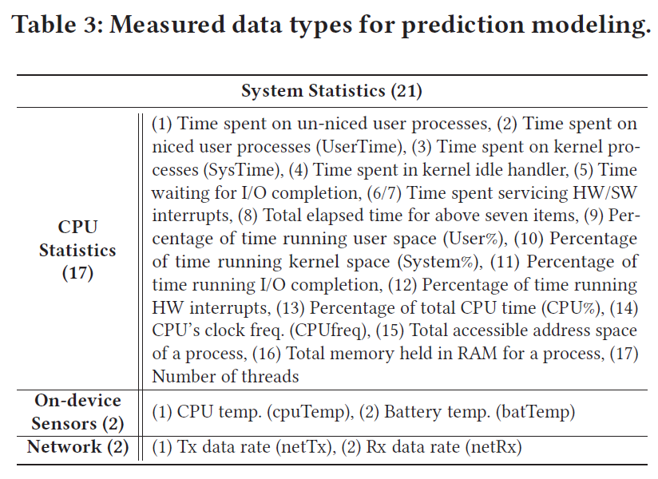
Features in Temperature Prediction Model
CorrelationAttributeEval :
Evaluates the worth of an attribute by measuring the correlation (Pearson's) between it and the class.
Nominal attributes are considered on a value by value basis by treating each value as an indicator. An overall correlation for a nominal attribute is arrived at via a weighted average.

Slide 35
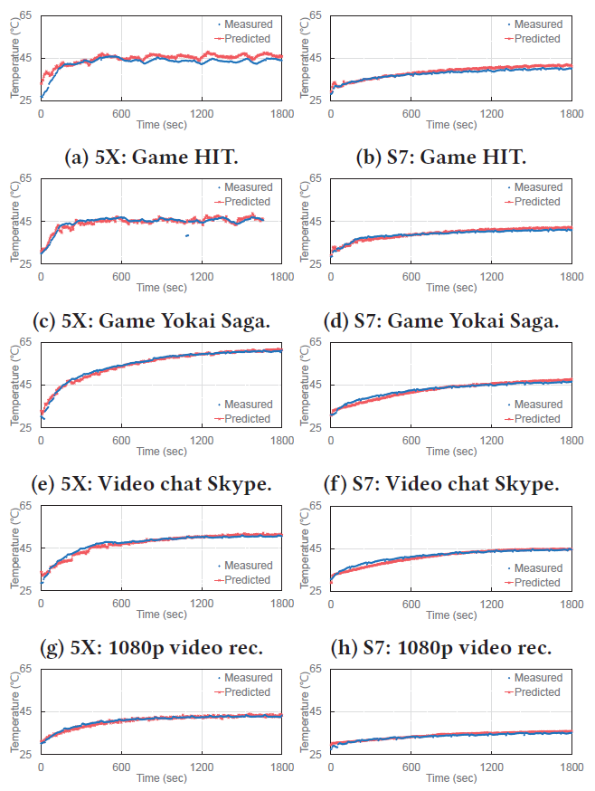
Temperature Prediction Model on Different Phones

Slide 36
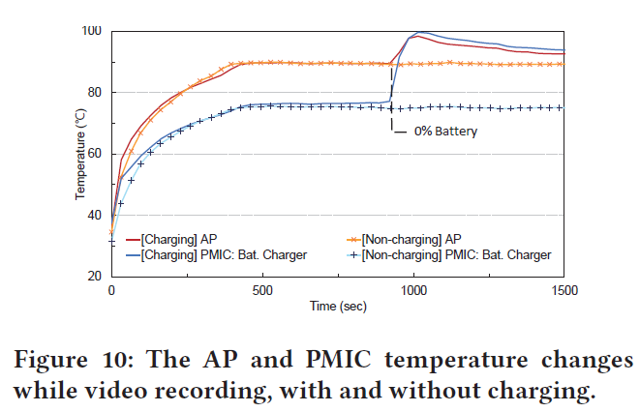
Fun Facts
GPS in your phone will generate much heat despite its relatively high power consumption, but direct sunlight exposure will.
Ubiquitous usage analysis
AR/VR application may cause heavy computing and make the surface exceed thermal pain threshold in minutes.
Charging algorithm.

